Slide 1

Database Management system
Database is any collection of electronic records that can be processed to produce useful information.

Slide 2
Data definition language(ddl)
CREATE DATABASE DATABASE-NAME;
Syntax of create database
CREATE DATABASE pgdit;

Slide 3
Data definition language(ddl)
CREATE TABLE courses(
course_id INTEGER(11) AUTO_INCREMENT NOT NULL,
course_name VARCHAR(100) NOT NULL,
course_code CHAR(15) NOT NULL,
PRIMARY KEY(course_id)
)ENGINE=INNODB DEFAULT CHARSET=latin1;
Primary Table
Syntax of create table

Slide 4
Data definition language(ddl)
CREATE TABLE students(
student_id INTEGER(11) AUTO_INCREMENT NOT NULL,
course_id INTEGER(11) NOT NULL,
student_roll INTEGER(11) NOT NULL,
student_name VARCHAR(100) NOT NULL,
student_email VARCHAR(150) NOT NULL,
student_mobile CHAR(15) NOT NULL,
student_gender VARCHAR(6) NOT NULL,
student_address VARCHAR(200) NOT NULL,
student_age INTEGER(3) NOT NULL,
PRIMARY KEY(student_id),
CONSTRAINT student_unique_key UNIQUE(student_email,student_mobile,student_roll);
CONSTRAINT student_course FOREIGN KEY(course_id) REFERENCES courses(course_id) ON UPDATE CASCADE ON DELETE RESTRICT
)ENGINE=INNODB DEFAULT CHARSET=latin1;
Syntax of create table

Slide 5
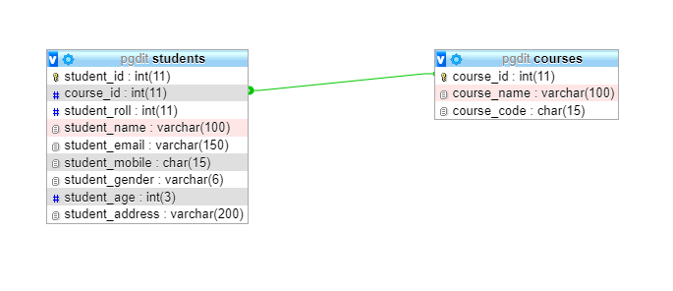
Visual relation between tables
Visual Relation between tables

Slide 6
Data manipulated language

Slide 7
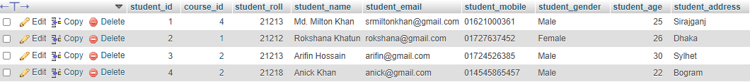
Select statment
The SELECT statement is used to select data from a database.
SELECT * FROM `students` ;
Syntax of create table
OUTPUT

Slide 8

MIN() Functions
The MIN() function returns the smallest value of the selected column.
SELECT MIN(`student_age`) FROM students WHERE student_gender = 'Male'
Syntax of create table
OUTPUT

Slide 9
MAX() Functions
The MAX() function returns the largest value of the selected column.
SELECT MAX(`student_age`) AS studentAgeMax FROM students
Syntax of Max Function
OUTPUT

Slide 10

COUNT() Functions
The COUNT() function returns the number of rows that matches a specified criterion.
SELECT COUNT(student_id) FROM students AS totalMaleStudent WHERE student_gender='Male'
Syntax of Count Function
OUTPUT

Slide 11

AVG() Functions
The AVG() function returns the average value of a numeric column.
The AVG() function returns the average value of a numeric column.
SELECT AVG(student_age) AS avarage_age FROM students
Syntax of AVG Function
OUTPUT

Slide 12
SUM() Functions
The SUM() function returns the total sum of a numeric column.
SELECT SUM(`student_age`) AS totalAge FROM students
Syntax of SUM() Function
OUTPUT

Slide 13
Not operator
The WHERE clause can be combined with NOT operators.
SELECT * FROM `students` WHERE NOT `student_gender` = 'male'
Syntax of NOT Operator
OUTPUT

Slide 14
Null = ‘ ’ operator
The COUNT() function returns the number of rows that matches a specified criterion.
SELECT * FROM `students` WHERE `student_address`= ‘ '
Syntax of NULL Operator
OUTPUT

Slide 15
LIKE operator
The LIKE operator is used in a WHERE clause to search for a specified pattern in a column.
Two wildcards often used in conjunction with the LIKE operator
wildcards
(%)
(_)

Slide 16
LIKE operator
Here are some examples showing different LIKE operators with '%' and '_' wildcards:
LIKE Operator | Description
WHERE CustomerName LIKE 'a%' | Finds any values that start with "a"
WHERE CustomerName LIKE '%a' | Finds any values that end with "a"
WHERE CustomerName LIKE '%or%' | Finds any values that have "or" in any position
WHERE CustomerName LIKE '_r%' | Finds any values that have "r" in the second position
WHERE CustomerName LIKE 'a_%' | Finds any values that start with "a" and are at least 2 characters in length
WHERE CustomerName LIKE 'a__%' | Finds any values that start with "a" and are at least 3 characters in length
WHERE ContactName LIKE 'a%o' | Finds any values that start with "a" and ends with "o"

Slide 17
LIKE operator
SELECT * FROM `students` WHERE `student_name` LIKE '%mil%'
Single quote must be assigned
OUTPUT

Slide 18
IN operator
The IN operator allows you to specify multiple values in a WHERE clause.
The IN operator is a shorthand for multiple OR conditions.
SELECT * FROM `students` WHERE `student_age`IN (22,26)
OUTPUT

Slide 19
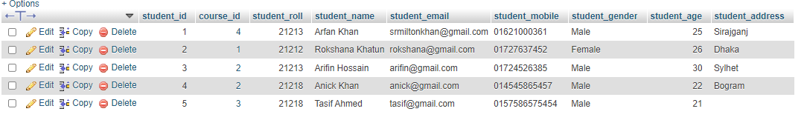
update statement
The UPDATE statement is used to modify the existing records in a table.
UPDATE students SET `student_name`='Arfan Khan' WHERE student_id = 1
OUTPUT
Syntax of Update

Slide 20
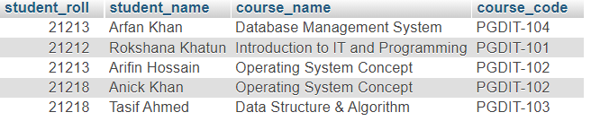
JOIN CLAUSE
A JOIN clause is used to combine rows from two or more tables, based on a related column between them.
Students Table
Courses Table

Slide 21
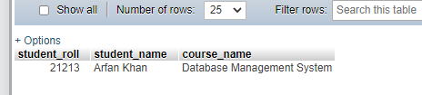
JOIN CLAUSE
SELECT student_roll, student_name, course_name FROM students INNER JOIN courses ON students.course_id = courses.course_id WHERE student_id = 1
ON Operator work as condition
OUTPUT

Slide 22
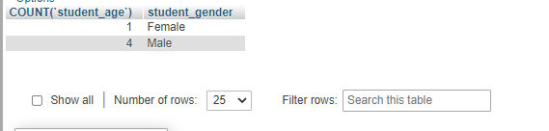
GROUP BY Statement
GROUP BY statement is often used with aggregate functions (COUNT(), MAX(), MIN(), SUM(), AVG()) to group the result-set by one or more columns.
SELECT COUNT(`student_age`), `student_gender` FROM students GROUP BY `student_gender`
OUTPUT

